Slide 1


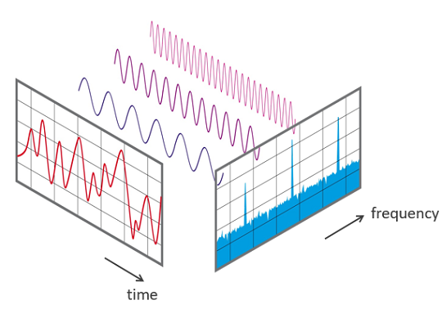
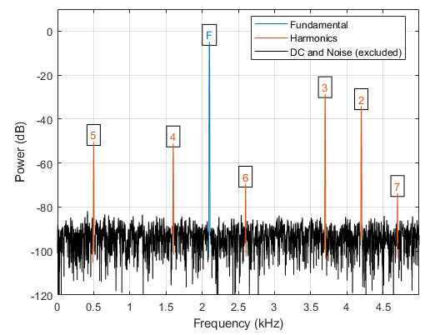
Lab 12 – Total Harmonic Distortion, THD
Objective:
The objective of this lab is to measure the total harmonic distortion of the audio amplifier using the FFT feature of the oscilloscope.

Slide 2
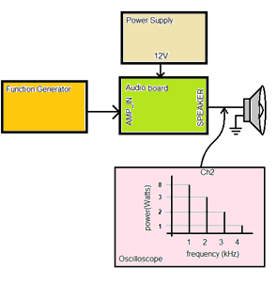
THD
It measures the power of the harmonics over the power of the fundamental frequency as a percentage.
You will measure THD by applying a
sine wave and measure the energy
contained in all harmonics.
The o’scope examines the output
of using FFT.
The question: how can you extract the power information from the FFT values?
Notes:
The Function Generator in Figure 1 is sending a 1kHz sine wave into the AMP_IN of the Audio board. - the amplitude of the input waveform is unimportant. We will assume that the function generator generates perfect sinusoidal inputs

Slide 3
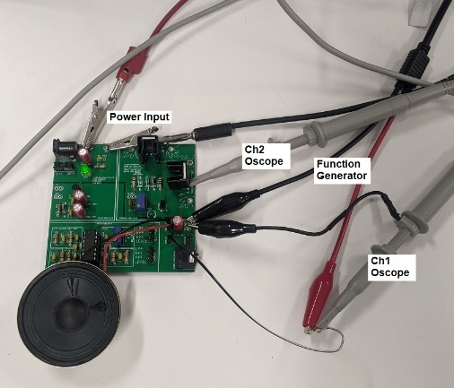
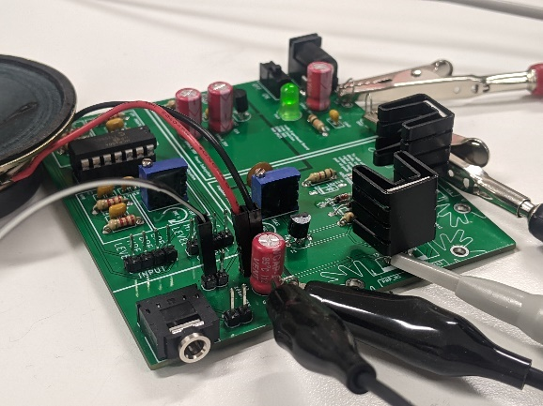
Measuring THD for Audio Amplifier
You will configure your lab bench test and measurement equipment to provide power to the Audio board.
The setup should look like this:

Slide 4
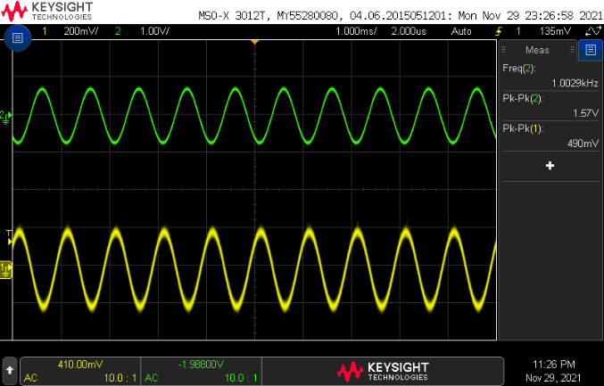
Measuring THD for Audio Amplifier
After power up the audio board and apply the input signal. You should see a pair of sine waves shown here:

Slide 5
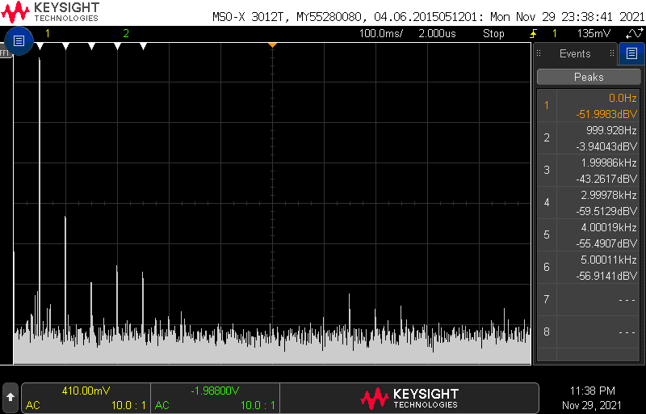
Measuring THD for Audio Amplifier
After you add the FFT to the oscilloscope, then you will be measuring the peaks of the FFT using the Search feature:

Slide 6
Tuning measurement
Threshold: The threshold level needed to be considered a peak
Excursion: The amplitude above the FFT waveform's noise floor
necessary to be recognized as a peak
When Averaged Value, Max Hold, or Min Hold are applied, the FFT waveform’s noise floor is more stable, and excursion level settings are more accurate.
White arrowheads at the top of the graticule show where FFT peaks are found

Slide 7
Turn in
Make a record of your response to numbered items and turn them in a single copy as a team on Canvas.
Table 1
Completed THD table with graph

